Slide 1
Prototype Pattern

Slide 2
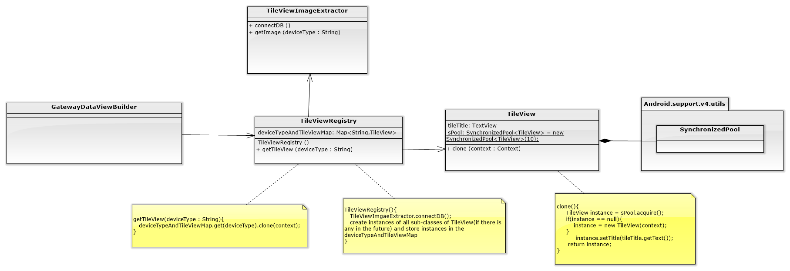
We have just one type of TileView now, but there may be more in the future .
Scenario:
After the TileViewRegistry being initiated, it will use TileViewImageExtractor to connect to BD for requesting all type of device images supported by gateway.
Then, the TileViewRegistry will create all types of Tileview by setting its specific device image and store them to a map recording the corresponding of device type and specific Tileview.
If the GatewayDataViewBuilder want to create a specific type TileView, it will use TileViewRegistry to get one. The TileViewRegistry clone the specific type Tileview stored and return.
We may use a pool to store Tileviews for performane issue.

